Slide 1



COMPLAINTS HANDLING REPORT

Slide 2

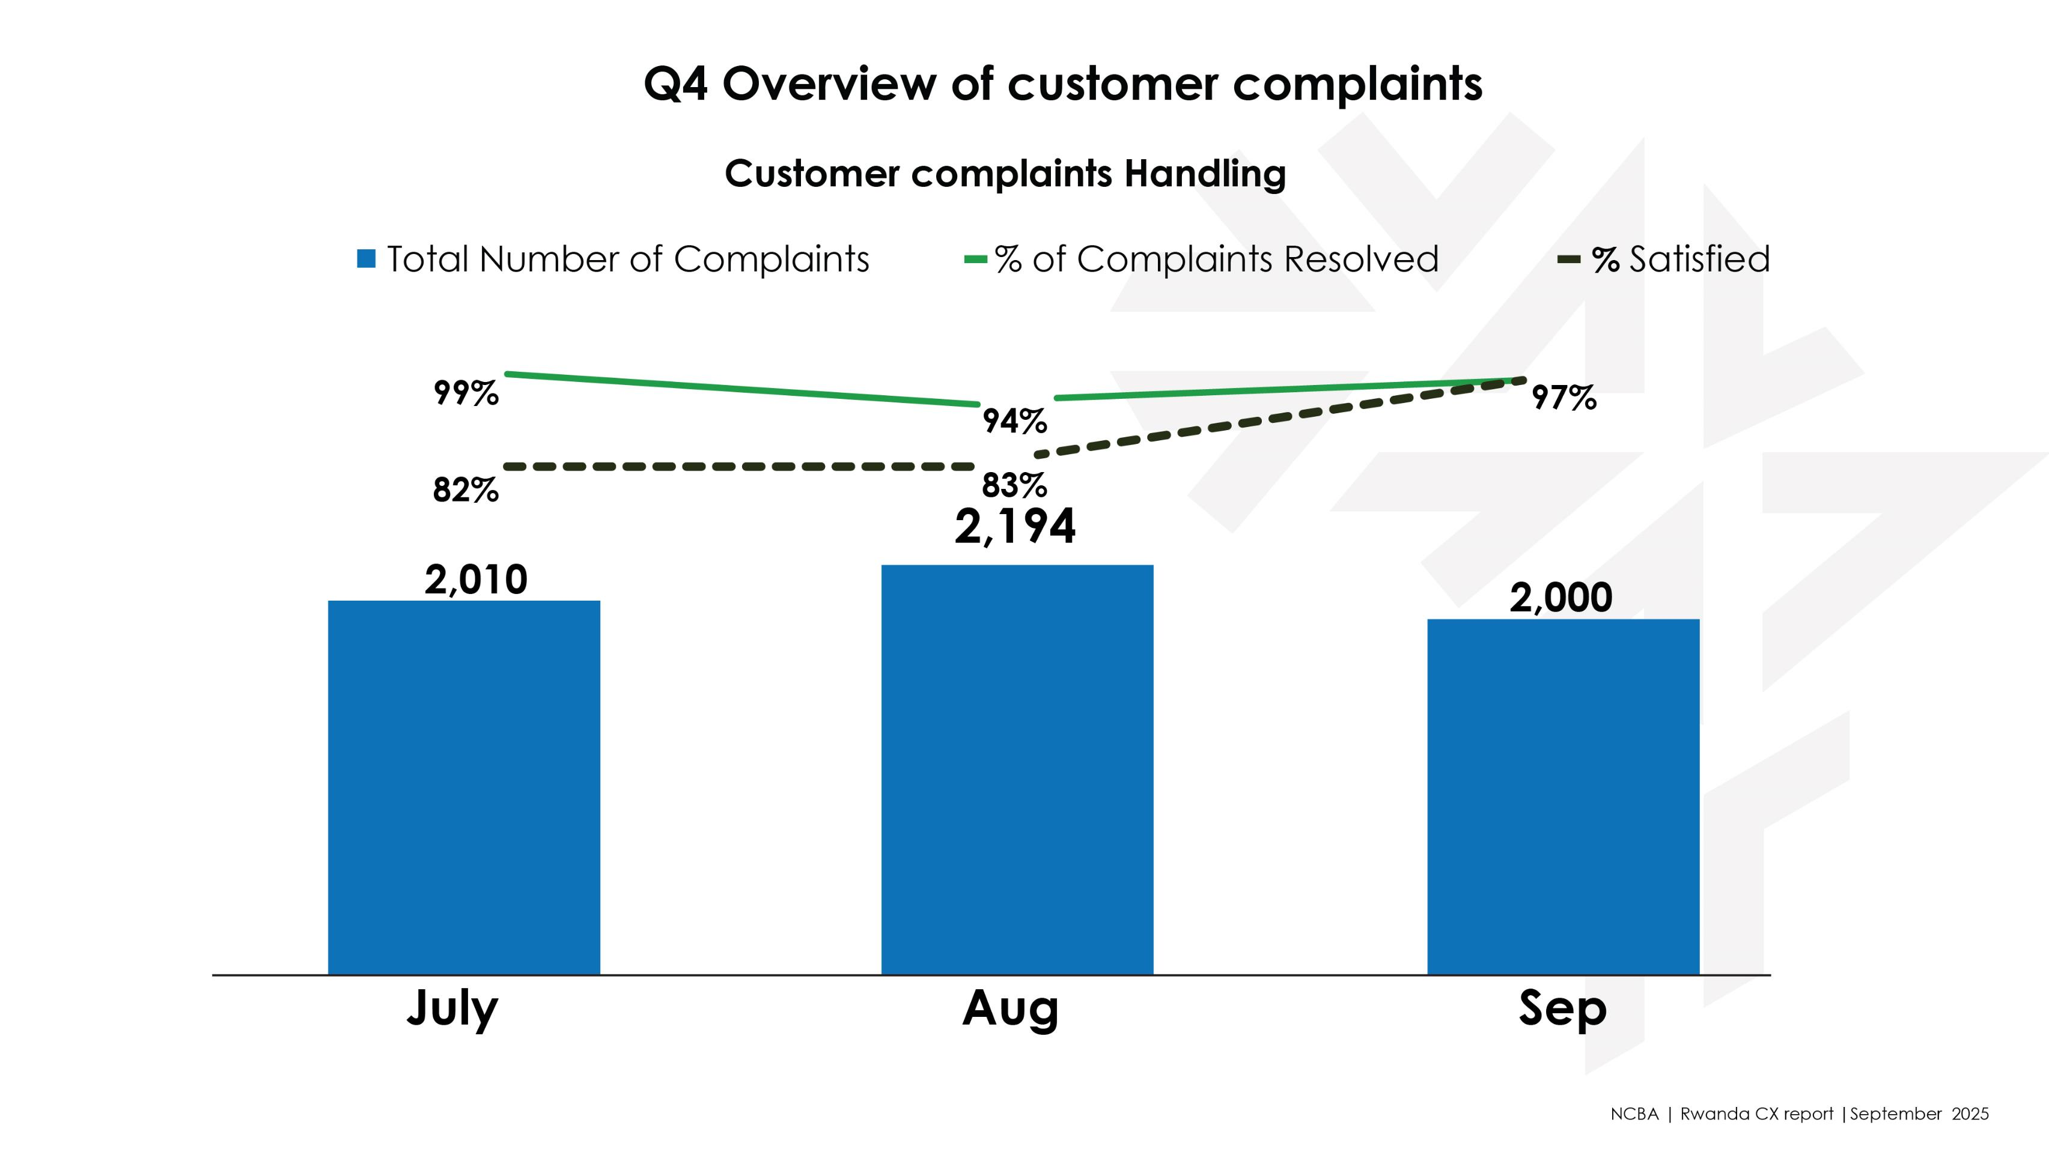

Slide 3

Q3 Overview of customer complaints
Denomination | JULY | AUG | SEP
Number of complaints received via CRM | 55 | 39 | 26
Number of complaints received via Calls | 319 | 363 | 65
Number of complaints received via Twitter | 15 | 13 | 12
Mokash Number of complaints received for handling | 1,621 | 1,779 | 1,897
Total Number of Complaints | 2,010 | 2,194 | 2,000
Total Number of Complaints Resolved (CRM, Calls, Twitter, MoKash) | 1,990 | 2,056 | 1,962
No. of Complainants Satisfied with Feedback | 1,635 | 1,707 | 1,912
% of Complaints Resolved | 99% | 94% | 98%
% Satisfied | 82% | 83% | 97%

